Slide 1





2025 IEEE iSSSC
2025 IEEE 3rd International Symposium on Sustainable Energy, Signal Processing & CyberSecurity
Paper Title:A Lightweight Attention-Enhanced Deep Learning Model Based on MobileNetV2 for Lung Cancer Detection
Paper ID:
Presenter Name:Akhil Duddi
Authors:Dodda Venkatreddy, Akhil Duddi, Silar Shaik, Paleti Rahul, Jajimoggala Sravanthi, Vippalapalli Vikas, K.V. Narasimha Reddy
Affiliation:Dept. of CSE, Narasaraopeta Engineering College Jntuk, India

Slide 2
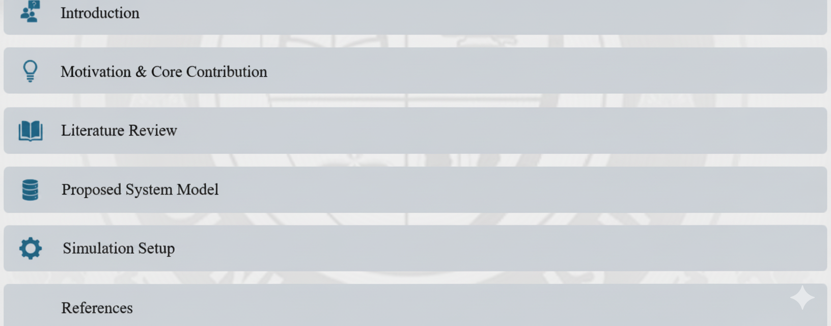
Outline

Slide 3
Introduction
Lung cancer is one of the leading causes of cancer-related deaths.
CT imaging is commonly used for diagnosis but prone to human error.
Deep learning, especially CNNs, enhances detection accuracy.
However, standard CNNs struggle with feature focus and computational load.
Aim: Develop a lightweight and interpretable model using MobileNetV2 with attention mechanism

Slide 4
Motivation & Core Contribution
Need for early, efficient, and accurate lung cancer diagnosis.
Traditional CNNs are computationally heavy and lack interpretability.
Proposed contributions:
Attention-enhanced MobileNetV2 for feature focus.
High accuracy (96%) with low computational cost.
Integration of Grad-CAM and LIME for explainability.
Demonstrated robustness through data augmentation and preprocessing

Slide 5
Literature Review
Prior works explored CNNs, SVMs, and hybrid models for lung cancer detection.
Early studies (Reem et al., Firdaus et al.) showed CNN effectiveness on CT scans.
Hybrid approaches combining texture features and deep learning improved accuracy.
Transfer learning models like EfficientNet and DenseNet show promise but are heavy.
Few studies focus on lightweight, interpretable models for clinical use.

Slide 6
Proposed System Model
Framework uses MobileNetV2 as the base architecture.
Integrated attention mechanism for spatial and channel focus.
Uses depthwise separable convolutions for reduced computation.
Architecture includes:
Input layer (224×224×3)
Global Average Pooling
Dropout (0.3)
Softmax output (4 classes)
Trained with augmented and normalized CT scan images.

Slide 7
Simulation Setup
Dataset: Kaggle CT-Scan Dataset (1000 images, 4 classes)
  Adenocarcinoma (338)
  Large Cell Carcinoma (187)
  Squamous Cell Carcinoma (260)
  Normal (215)
Preprocessing:
  Resizing (224×224)
  White balancing
  CLAHE enhancement
  Normalization ([0,1])
Training Setup:
  5-fold cross-validation
  Optimizer: Adam
  Epochs: 10
  Evaluation metrics: Accuracy, Precision, Recall, F1-score

Slide 8
Result and Discussion
MobileNetV2 achieved 96% accuracy—best among tested models.
EfficientNetV2: 95%, DenseNet121: 91%, ResNet50: 84%.
Stable training and validation curves show strong generalization.
Attention mechanism improved focus on key lung regions.
Explainable AI tools (Grad-CAM, LIME) visualized model decision areas.

Slide 9
Conclusion & Future Work
Developed a lightweight, attention-enhanced CNN for multiclass lung cancer detection.
Achieved high accuracy (96%) with reduced computation.
Demonstrated strong interpretability and clinical potential.
Future work:
Expand dataset
Explore 3D volumetric CT analysis
Apply ensemble and hybrid models for better diagnostics

Slide 10
References
Reem et al., IEEE ICECE 2024
Firdaus et al., IES 2020
Binson & Subramoniam, ICCSDET 2018
Shafiq et al., ICOSST 2022
Sultana et al., EICT 2021

Slide 11
Reviewer Comments Addressed
Clarified dataset preprocessing steps.
Added evaluation comparison among models.
Enhanced explainability discussion with Grad-CAM and LIME.
Provided practical scope for clinical integration.

Slide 12
Thank You
Questions?
Contact: akhilduddi95@gmail.com

